Slide 1


Slide 2


Genetic Algorithms and the Traveling Salesman Problem
Matthew Bagazinski and Pete Szyjka
Faculty Mentor: Dr. Jeffrey Kastner, Dr. Manish Kumar
GRA: Siddharth Sridhar
NSF Grant EEC-17110826

Slide 3

Abstract
Research Training
Goals, Objectives, Research Tasks
Introduction
Sample Problem
Background Information
Research Timeline
Progress, Results
Teacher Specific Activities
Questions

Slide 4

Research Training
Library research methods
Journal article writing
Engineering design process
Coding review
Coding academic Traveling Salesman Problems and their approaches
Field trips
Advisor-GRA discussions

Slide 5

Abstract
Travelling salesmen want to find the shortest distance over a route of destinations, visiting each only once
The Travelling Salesperson Problem (TSP) has commercial applications but computation cost is prohibitive as the number of destinations increase
A genetic algorithm is a method to help find TSP “good enough” solutions
With various techniques, we create a more efficient algorithm to find the shortest paths

Slide 6


Goals Objectives Tasks
Understand the TSP
Understand, exploit various solution methods
Improve coding skills
Add to body of knowledge of TSP solutions
Attempt to improve TSP solutions with more efficient code (Research Task ), e.g., more destinations, shorter computation time

Slide 7

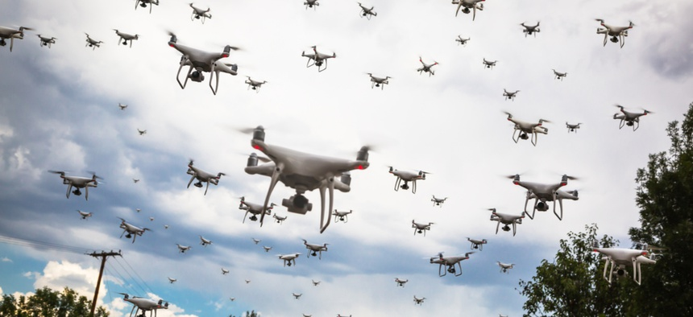
Introduction
What is the Travelling Salesman Problem?
What are applications?
Why do people study it?

Slide 8
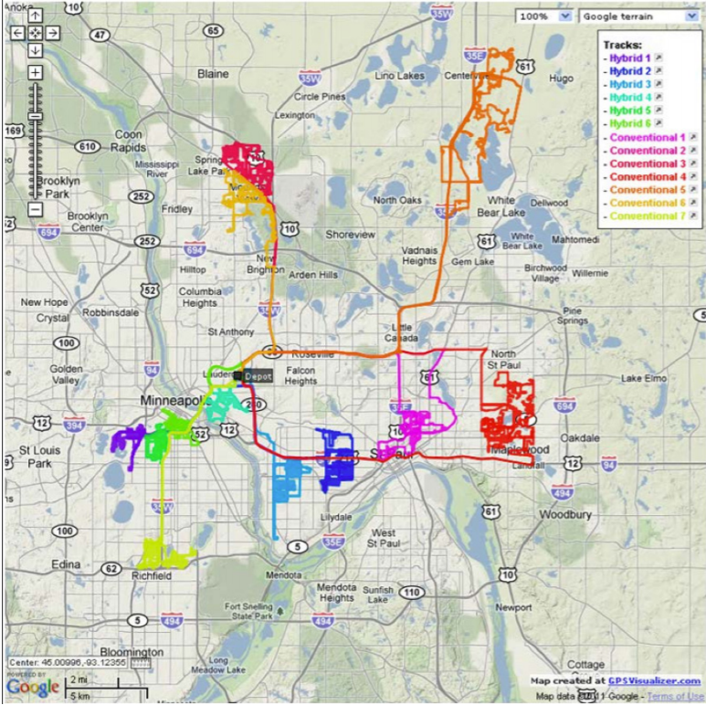


Visualizing The Problem
What’s the shortest, cheapest, fastest path ?
How should one cluster routes if multiple salesmen are available?
Should I use a model that checks every possible combination of paths?

Slide 9
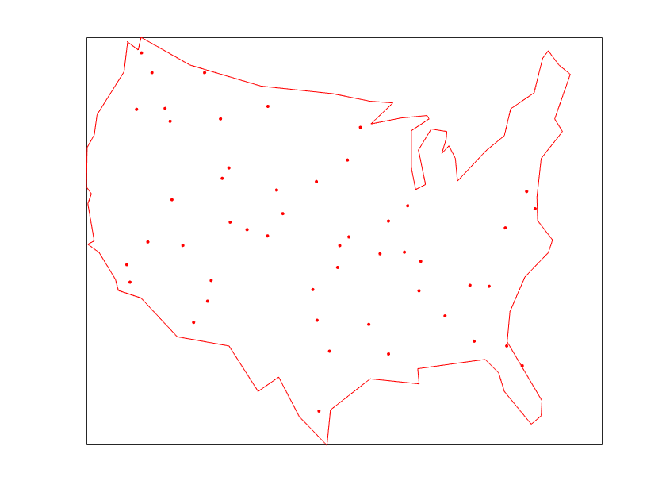

Background – Traveling Salesman Problem
TSP objective …. The shortest path
Go to every city, return home
How many cities? N
How many possible paths? O(N!)
Most probable system reaction:
United States Selection of Delivery Cities
Solutions ?

Slide 10
Traveling Salesman Problem
Practical Solution
Assume :
N = 4 Cities….
Use a Brute Force Method:
N! Possible Permutations of Route Searches
for the shortest path
SOME ROUTE COMBINATIONS OF 4 CITIES
 | SEQUENCE OF TRAVEL-> |  |  |  |  | RETURN TO CITY
 | 1 | 2 | 3 | 4 |  | 1
 | 1 | 2 | 4 | 3 |  | 1
 | 1 | 3 | 2 | 4 |  | 1
 | 1 | 4 | 3 | 2 |  | 1
 | 2 | 1 | 4 | 3 |  | 2
 | 2 | 1 | 3 | 4 |  | 2
 | 2 | 3 | 4 | 1 |  | 2
 | 2 | 4 | 3 | 1 |  | 2
But some permutations are the same routes
in reverse
Also, some permutations cover the same circuit, but start from a different city

Slide 11
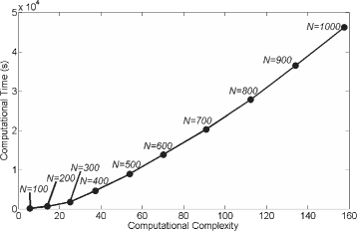
Traveling Salesman Problem
Practical Solutions
With Duplicates (Reversed Routes and Closed Loop): Now (N-1)!/2 Routes
EXAMPLES of COMPUTATIONAL COMPLEXITY
N=10 Cities, Possible Routes: 9!/2= 181440
N=100 Cities, Possible Routes: 99!/2= 9.33 x 10¹⁵⁵ /2
N=1000 Cities, Possible Routes: 999!/2= Not in this lifetime
Enter Genetic / Evolutionary Algorithms:

Slide 12
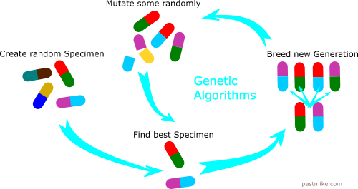
PROPOSED SOLUTION:
Genetic Algorithm (GA)
Inspired by biology, a GA creates population of paths through random “mutations” or “crossbreeding”
The most fit (that means the shortest paths) survive to breed the next generation
Let’s look at a simplified numerical sample:

Slide 13
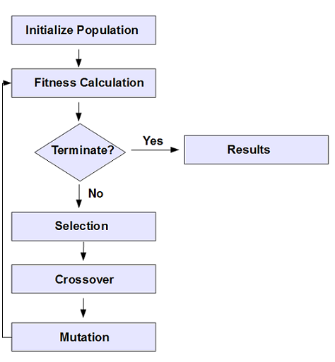
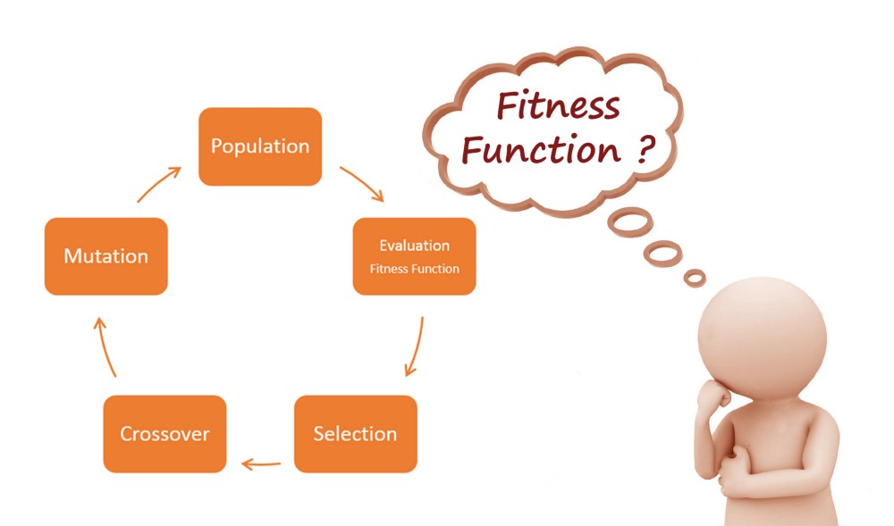
Traveling Salesman Problem
Practical Solutions….Genetic Algorithms
Genetic Computation Flow
INITIALIZE Benchmark Code:
2 ‘populations’ of 4, in a random routing of 8 cities
pop = [ 8 6 4 5 1 7 3 2
8 2 3 1 6 5 4 7
5 2 1 7 6 8 3 4
7 6 3 8 5 4 1 2
4 6 2 7 3 8 5 1
4 5 8 6 3 7 1 2
5 2 6 4 8 7 1 3
6 1 4 3 8 7 2 5]
Separate them in to sets of 4 cities and evaluate their FITNESS

Slide 14
Traveling Salesman Problem
Practical Solutions….Genetic Algorithms
Genetic Computation Flow
2 Group Route Sequence Total Distance
8 6 4 5 1 7 3 2 37.3
2 3 1 6 5 4 7 8 54.6
5 2 1 7 6 8 3 4 67.8
7 6 3 8 5 4 1 2 33.4
4 6 2 7 3 8 5 1 44.7
4 5 8 6 3 7 1 2 74.1
5 2 6 4 8 7 1 3 44.3
6 1 4 3 8 7 2 5 54.6
TERMINATE? No
How do we know if those are the best-shortest?
Iterate…….
SELECTION
MUTATION

Slide 15

Traveling Salesman Problem
Practical Solutions….Genetic Algorithms
Mutation and Repopulation
Mutation and Repopulation
Only the fittest route in each group reproduces
Two locations on the route are randomly chosen and modified
2 Group Route Sequence Mutation Type
7 6 3 8 5 4 1 2 No Change
7 5 8 3 6 4 1 2 Flip
7 5 3 8 6 4 1 2 Swap
7 3 8 5 6 4 1 2 Shift
5 2 6 4 8 7 1 3 No Change
5 2 1 7 8 4 6 3 Flip
5 2 1 4 8 7 6 3 Swap
5 2 4 8 7 1 6 3 Shift
These new routes get randomly sorted into groups of four, and this process repeats for a preset number of generations

Slide 16

Traveling Salesman Problem
Practical Solutions….Genetic Algorithms
Our Approach
All Routes Sorted Total Distance
7 6 3 8 5 4 1 2 33.4
8 6 4 5 1 7 3 2 37.3
5 2 6 4 8 7 1 3 44.3
4 6 2 7 3 8 5 1 44.7
2 3 1 6 5 4 7 8 54.6
6 1 4 3 8 7 2 5 54.6
5 2 1 7 6 8 3 4 67.8
4 5 8 6 3 7 1 2 74.1
Selection and Mutation
Sort the entire population
Only top three routes reproduce
Mutations are randomized
Additional type of mutation – 3 segments

Slide 17
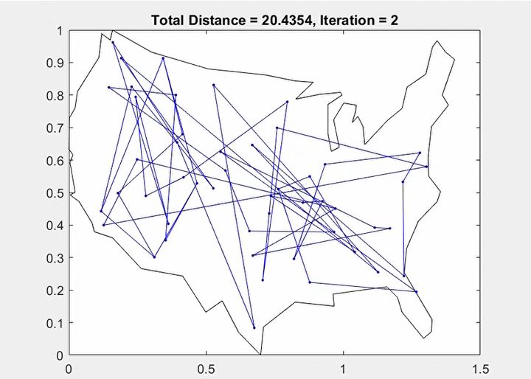
Genetic
Algorithm in Action

Slide 18
Comparison of Algorithms
As population size increases, number of generations before convergence decreases
Slopes suggest our genetic algorithm converges more quickly toward asymptote
  Why? Team algorithm mutation, selection process

Slide 19
Comparison of Genetic Algorithms
Example from each algorithm shows team convergence at earlier generation
Doesn’t tell the whole story, since the algorithms may take different amounts of time to compute each generation

Slide 20
Temporal Analysis
Time to reach different path length?
How much less time than the Benchmark?
Fraction of the Initial Route Distance | Benchmark GA Time in Seconds | Alternative GA Time in Seconds | % Decrease in Time from Benchmark
0.50 | 0.030277 | 0.015952 | 47.3%
0.45 | 0.040719 | 0.01778 | 56.3%
0.40 | 0.056924 | 0.023829 | 58.1%
0.35 | 0.071448 | 0.029891 | 58.2%
0.30 | 0.09109 | 0.04545 | 50.1%
0.25 | 0.250238 | 0.079731 | 68.1%
0.24 | 0.335671 | 0.087295 | 73.9%

Slide 21
Research Results and Conclusion
Alternative GA demonstrated improved performance
  More rapid convergence: Steeper slope
  More computationally efficient: Less time to reach each distance
Further research is needed to understand the impact of each of the changes made:
  Only top three reproduce vs. best of four
  Randomized mutations vs. sequential (flip, swap, shift)
  Additional mutation type – three segment

Slide 22
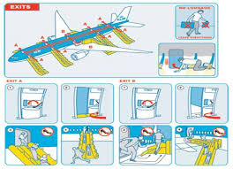

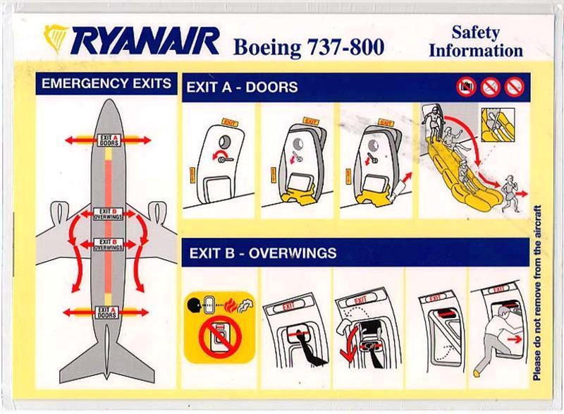
Math Unit: Design of Experiments
Topic: The TSP
Using a Design of Experiments (DOE) approach determine the best arrangement (timing) of emergency exits for:
  Airliner cabin
  Building
Hook approaches :
    Provocative videos
    Airport “field trip”
    Practice fire drill
Activities considered :
    Classroom chair / hypothetical exit arrangements
    Building /building exit, open vs. blocked arrangement

Slide 23



Physics Unit: Design an Efficient School Day
Based on steps walked and stairs climbed, calculate your energy usage through your school day
How could you arrange your schedule to minimize energy use? To maximize?
Where would be the best
locker placement?
Constraints: announcements are
in the morning and lunch
is in the middle of the day

Slide 24


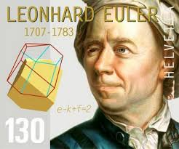

Questions? Comments? Gripes? Complaints? Critiques?

Slide 25
Video
https://www.youtube.com/watch?v=dGHmHTc9zoI&feature=youtu.be

Slide 26
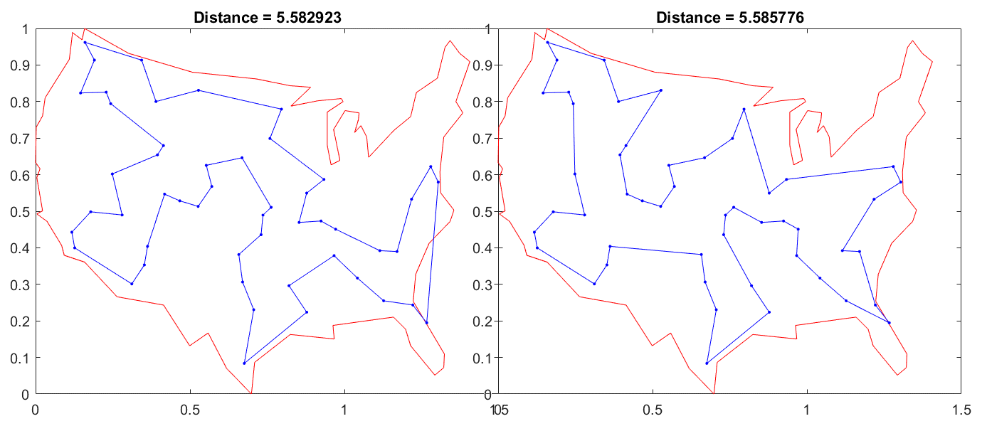

Example Results
Best path AREAS: Similar Different

Slide 27
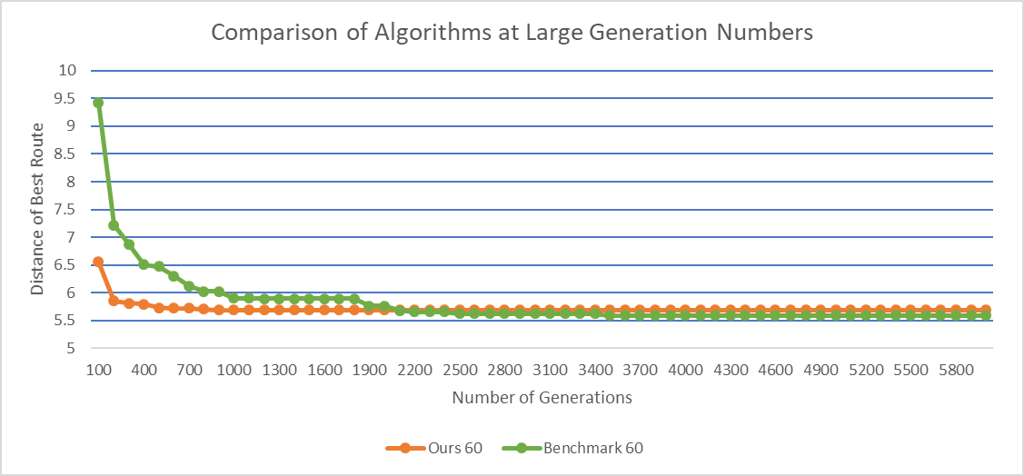

Analysis
Number of generations to an optimal path
Time to come within 5% of the optimal path?
~2000 Generations crossover
3-Opt computational intensity
Probable “Best Routes”
Stabilized
Early Stable results
Probable Time-Sensitive Solution

Slide 28
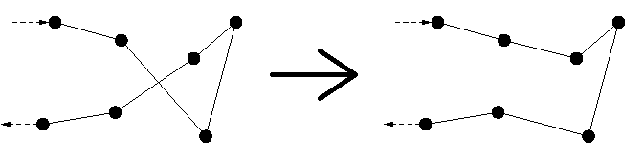
2-Opt
Once we have a path established, the 2-Opt algorithm can refine it
Essentially switches two paths to see which provides the shorter distance
(Pseudocode)
For each path
  Switch with another path
    Check to see which is shorter
    If new path is shorter, modify path

